Slide 1
Spark and Python for Big Data (PySpark) (Session 1)
Dr. Hatem Elattar
<number>

Slide 2
Agenda
Big Data.
Hadoop.
Apache Spark and Its Components.
Apache Spark’s Distributed Execution.
Resilient Distributed Datasets (RDDs)
Spark SQL and DataFrames.
2

Slide 3
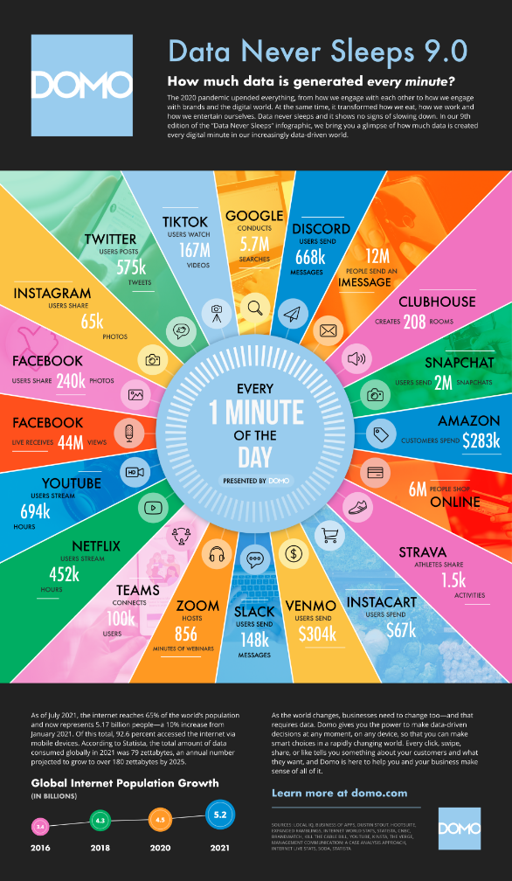

Data
Data Is
The New Oil

Slide 4
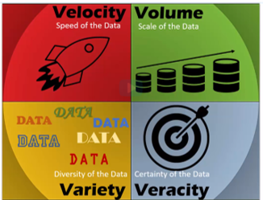
Big Data
Big data is high-volume, high-velocity and/or high-variety information assets that demand cost-effective, innovative forms of information processing that enable enhanced insight, decision making, and process automation. [Gartner]
4

Slide 5
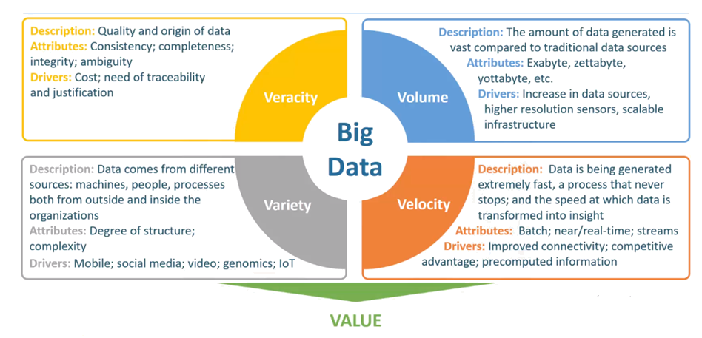
Big Data
<number>

Slide 6
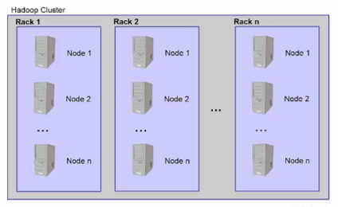
Hadoop
Apache Hadoop is an open source, Java-based, software framework and parallel data processing engine.
It enables big data analytics processing tasks to be broken down into smaller tasks that can be performed in parallel by using an algorithm (like the MapReduce algorithm), and distributing them across a Hadoop cluster.
A Hadoop cluster is a collection of computers, known as nodes, that are networked together to perform these kinds of parallel computations on big data sets.
Unlike other computer clusters, Hadoop clusters are designed specifically to store and analyze mass amounts of structured and unstructured data in a distributed computing environment.
<number>

Slide 7
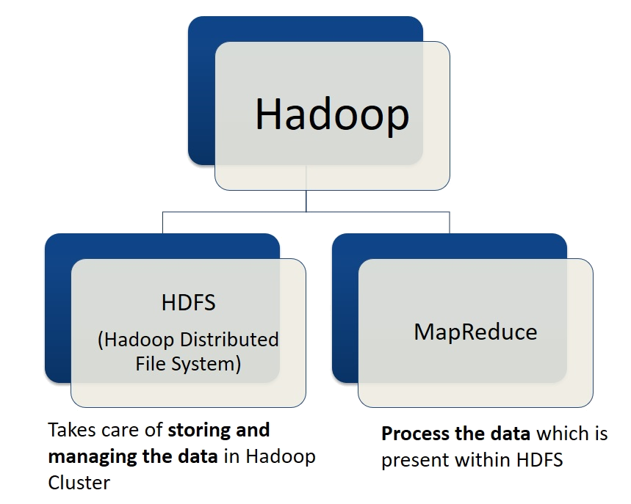
Hadoop
<number>

Slide 8
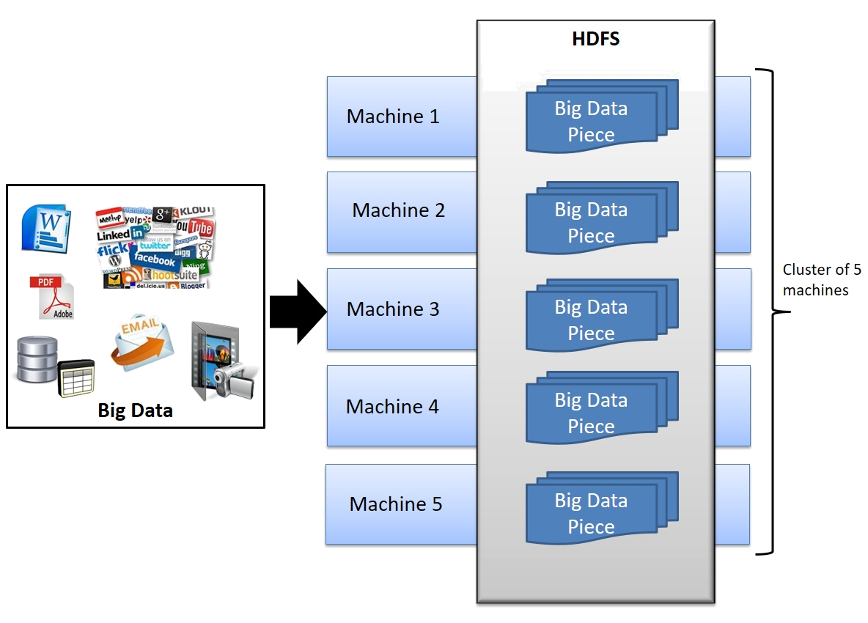
Hadoop
HDFS is a Hadoop distributed file system for storing large files on cluster of machines. HDFS does data chunking and distribute data across different machines.
<number>

Slide 9
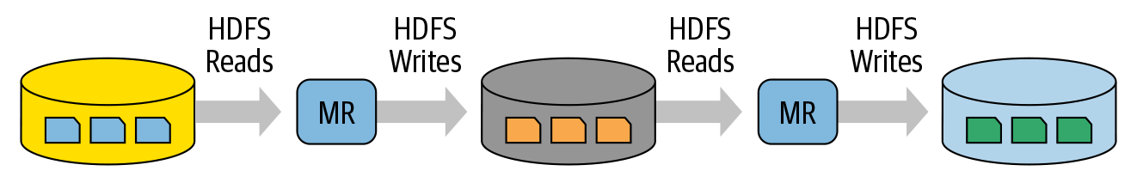
Hadoop
MapReduce is widely adopted for processing and generating large datasets with a parallel, distributed algorithm on a cluster. It allows users to write parallel computations, using a set of high-level operators, without having to worry about work distribution and fault tolerance.
Unfortunately, in most current frameworks, the only way to reuse data between computations (Ex − between two MapReduce jobs) is to write it to an external stable storage system (Ex − HDFS).
Both Iterative and Interactive applications require faster data sharing across parallel jobs. Data sharing is slow in MapReduce due to replication, serialization, and disk IO. Regarding storage system, most of the Hadoop applications, they spend more than 90% of the time doing HDFS read-write operations.
Hadoop is designed to handle very large files. i.e. batch processing.
Intermittent iteration of reads and writes between map and reduce computations
<number>

Slide 10
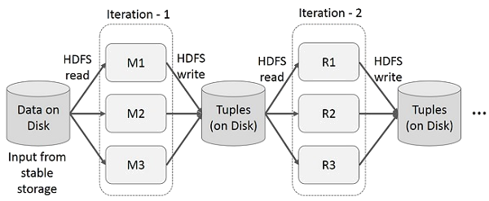
Hadoop
Iterative Operations on MapReduce
Reuse intermediate results across multiple computations in multi-stage applications. This incurs substantial overheads due to data replication, disk I/O, and serialization, which makes the system slow.
<number>

Slide 11
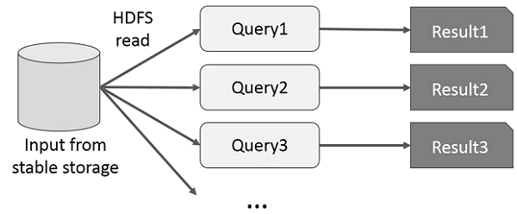
Hadoop
Interactive Operations on MapReduce
User runs ad-hoc queries on the same subset of data. Each query will do the disk I/O on the stable storage, which can dominate application execution time.
<number>

Slide 12
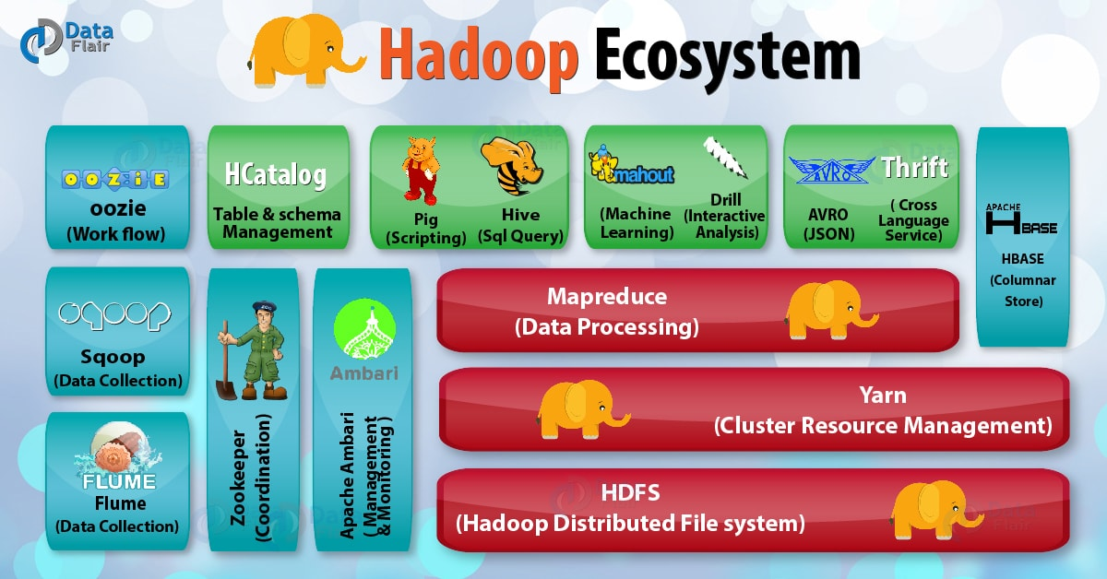
Hadoop Ecosystem
MapReduce Limitations:
Difficulty of programming in MapReduce.
Batch processing does not fit many use cases.
MapReduce spawned a lot of specialized systems e.g. Storm, Impala, Giraph … etc.
<number>

Slide 13
Apache Spark
Early papers published on Spark demonstrated that it was 10 to 20 times faster than Hadoop MapReduce for certain jobs. Today, it’s many orders of magnitude faster (100x).
The central thrust of the Spark project was to bring in ideas borrowed from Hadoop Map‐ Reduce, but to enhance the system:
make it highly fault tolerant and embarrassingly parallel;
support in-memory storage for intermediate results between iterative and interactive map and reduce computations;
offer easy and composable APIs in multiple languages as a programming model, and support other workloads in a unified manner.
13

Slide 14
Apache Spark
Apache Spark is a unified engine designed for large-scale distributed data processing, on premises in data centers or in the cloud.
Spark provides in-memory storage for intermediate computations, making it much faster than Hadoop MapReduce.
It incorporates libraries with composable APIs for machine learning (MLlib), SQL for interactive queries (Spark SQL), stream processing (Structured Streaming) for interacting with real-time data, and graph processing (GraphX).
Spark’s design philosophy centers around four key characteristics:
Speed
Ease of use
Modularity
Extensibility
14

Slide 15
Spark’s Design Philosophy
Speed
Spark has pursued the goal of speed in several ways:
First, its internal implementation benefits immensely from the hardware industry’s recent huge strides in improving the price and performance of CPUs and memory.
Second, Spark builds its query computations as a directed acyclic graph (DAG); its DAG scheduler and query optimizer construct an efficient computational graph that can usually be decomposed into tasks that are executed in parallel across workers on the cluster.
And third, its physical execution engine, Tungsten, uses whole-stage code generation to generate compact code for execution
With all the intermediate results retained in memory and its limited disk I/O, this gives it a huge performance boost.
15

Slide 16
Spark’s Design Philosophy
Ease of Use
Spark achieves simplicity by providing a fundamental abstraction of a simple logical data structure called a Resilient Distributed Dataset (RDD) upon which all other higher-level structured data abstractions, such as DataFrames and Datasets, are constructed.
By providing a set of transformations and actions as operations, Spark offers a simple programming model that you can use to build big data applications in familiar languages.
16

Slide 17
Spark’s Design Philosophy
Modularity
Spark operations can be applied across many types of workloads and expressed in any of the supported programming languages: Scala, Java, Python, SQL, and R.
Spark offers unified libraries with well-documented APIs that include the following modules as core components: Spark SQL, Spark Structured Streaming, Spark MLlib, and GraphX, combining all the workloads running under one engine.
You can write a single Spark application that can do it all—no need for distinct engines for disparate workloads, no need to learn separate APIs. With Spark, you get a unified processing engine for your workloads.
17

Slide 18
Spark’s Design Philosophy
Extensibility
Spark focuses on its fast, parallel computation engine rather than on storage. Unlike Apache Hadoop, which included both storage and compute, Spark decouples the two.
That means you can use Spark to read data stored in myriad sources—Apache Hadoop, Apache Cassandra, Apache HBase, MongoDB, Apache Hive, RDBMSs, and more—and process it all in memory.
Spark’s DataFrameReaders and DataFrame Writers can also be extended to read data from other sources, such as Apache Kafka, Kinesis, Azure Storage, and Amazon S3, into its logical data abstraction, on which it can operate.
18

Slide 19
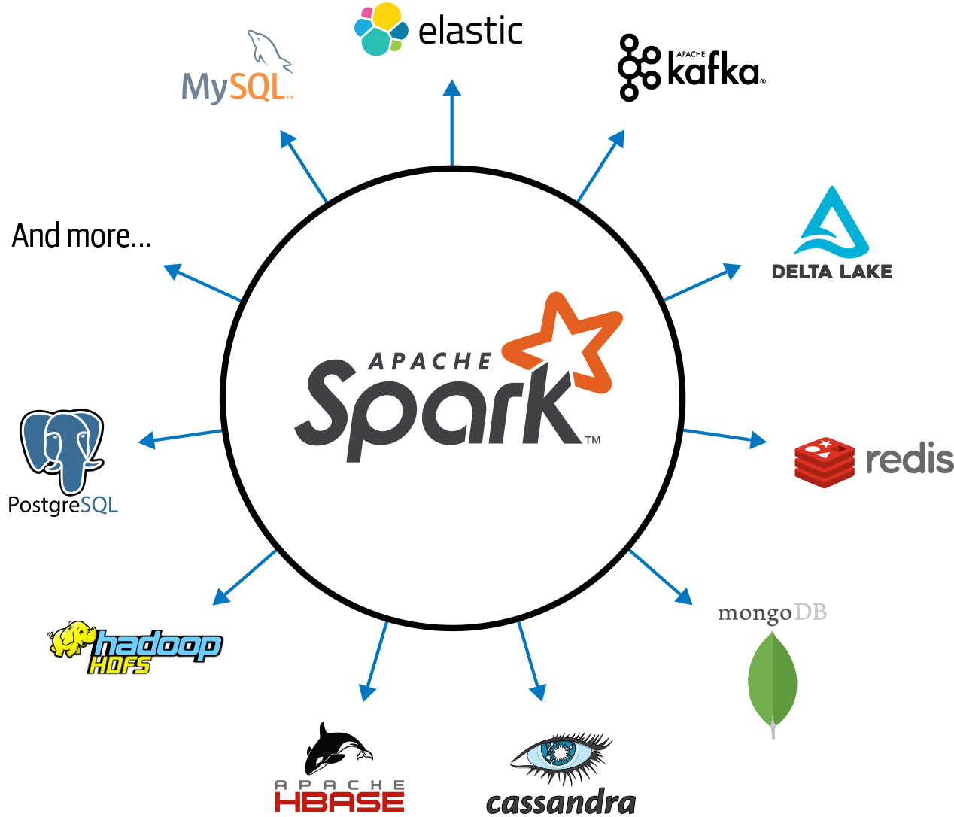
Apache Spark’s ecosystem of connectors
The community of Spark developers maintains a list of third-party Spark packages as part of the growing ecosystem. This rich ecosystem of packages includes Spark connectors for a variety of external data sources, performance monitors, and more.
19

Slide 20
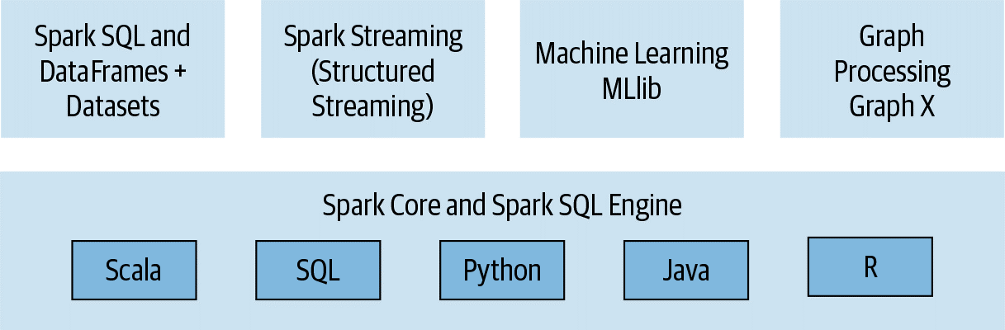
Apache Spark
Unified Analytics:
Spark replaces all the separate batch processing, graph, stream, and query engines like Storm, Impala, Dremel, Pregel, etc. with a unified stack of components that addresses diverse workloads under a single distributed fast engine.
Cluster Resource Manager (Standalone Scheduler, YARN, Mesos, Kubernetes)
Distributed Storage(HDFS, S3, Hive, etc.. )
20

Slide 21
Apache Spark
Spark offers four distinct components as libraries for diverse workloads: Spark SQL, Spark MLlib, Spark Streaming (Structured Streaming), and GraphX (GraphFrames).
Each of these components is separate from Spark’s core fault-tolerant engine, in that you use APIs to write your Spark application and Spark converts this into a DAG (Directed Acyclic Graph) that is executed by the core engine. So whether you write your Spark code using the provided Structured APIs in Java, R, Scala, SQL, or Python, the underlying code is decomposed into highly compact bytecode that is executed in the workers’ JVMs across the cluster.
21

Slide 22
Spark SQL
This module works well with structured data. You can read data stored in an RDBMS table or from file formats with structured data (CSV, text, JSON, Avro, ORC, Parquet, etc.) and then construct permanent or temporary tables in Spark.
When using Spark’s Structured APIs in Java, Python, Scala, or R, you can combine SQL queries to query the data just read into a Spark DataFrame.
Spark SQL is ANSI SQL:2003-compliant and it also functions as a pure SQL engine.
22

Slide 23
Spark MLlib
Spark comes with a library containing common machine learning (ML) algorithms called Mllib.
MLlib provides many popular machine learning algorithms built atop high-level DataFrame-based APIs to build models. (spark.ml is now the used ML library based on DataFrame).
These APIs allow you to extract or transform features, build pipelines (for training and evaluating), and persist models (for saving and reloading them) during deployment.
Additional utilities include the use of common linear algebra operations and
statistics.
23

Slide 24
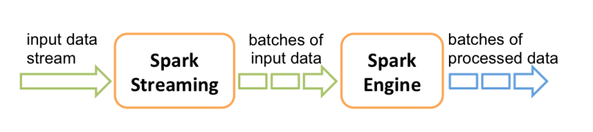
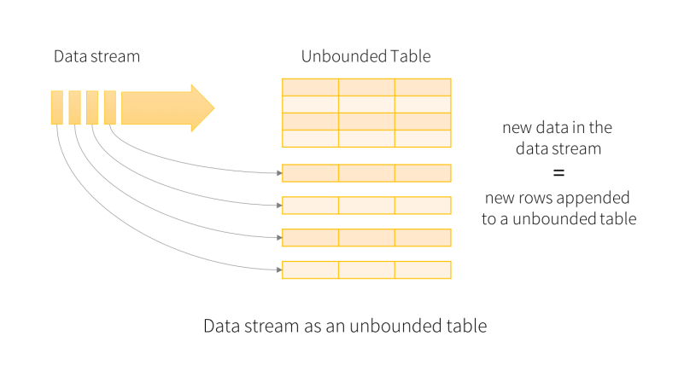
Spark Streaming
Spark Streaming is an extension of the core Spark API that enables scalable, high-throughput, fault-tolerant stream processing of live data streams. Data can be ingested from many sources like Kafka, Kinesis, or TCP sockets, and can be processed using complex algorithms expressed with high-level functions like map, reduce, join and window. Finally, processed data can be pushed out to filesystems, databases, and live dashboards. In fact, you can apply Spark’s machine learning and graph processing algorithms on data streams.
Apache Spark 2.0 introduced an experimental Continuous Streaming model and Structured Streaming APIs, built atop the Spark SQL engine and DataFrame-based APIs. By Spark 2.2, Structured Streaming was generally available, meaning that developers could use it in their production environments.
Necessary for big data developers to combine and react in real time to both static data and streaming data from engines like Apache Kafka and other streaming sources, the new model views a stream as a continually growing table, with new rows of data appended at the end. Developers can merely treat this as a structured table and issue queries against it as they would a static table.
Underneath the Structured Streaming model, the Spark SQL core engine handles all aspects of fault tolerance and late-data semantics, allowing developers to focus on writing streaming applications with relative ease.
24

Slide 25
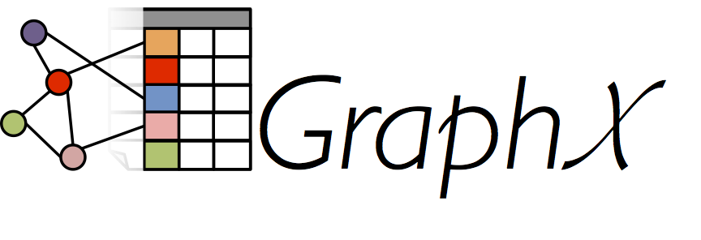
Spark GraphX
GraphX is a library for manipulating graphs (e.g., social network graphs, routes and connection points, or network topology graphs) and performing graph-parallel computations.
GraphFrames: GraphX is to RDDs as GraphFrames are to DataFrames.
The functionality of GraphFrames and GraphX is essentially the same, the only difference is that GraphFrames are based upon Spark DataFrames, rather than RDDs.
25

Slide 26
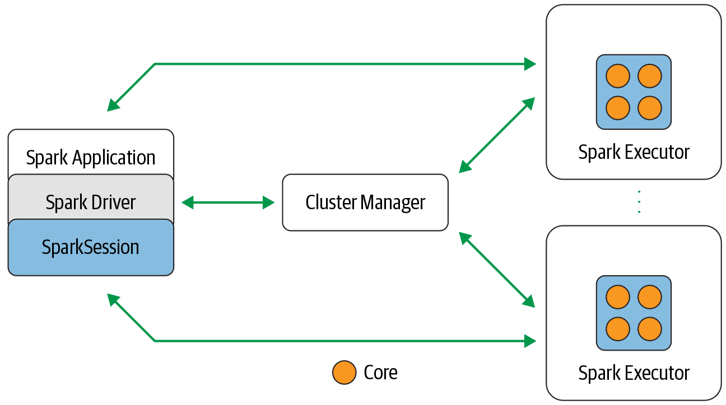
Apache Spark’s Distributed Execution
Apache Spark is a distributed data processing engine with its components working collaboratively on a cluster of machines.
26

Slide 27
Apache Spark’s Distributed Execution
Spark application consists of a driver program that is responsible for orchestrating parallel operations on the Spark cluster.
The driver accesses the distributed components in the cluster—the Spark executors and cluster manager—through a SparkSession.
27

Slide 28
Spark Driver
As the part of the Spark application responsible for instantiating a SparkSession, the Spark driver has multiple roles: it communicates with the cluster manager; it requests resources (CPU, memory, etc.) from the cluster manager for Spark’s executors (JVMs); and it transforms all the Spark operations into DAG computations, schedules them, and distributes their execution as tasks across the Spark executors. Once the resources are allocated, it communicates directly with the executors.
28

Slide 29
SparkSession
SparkSession provides a single unified entry point to all of Spark’s functionality.
Through this one conduit, you can create JVM runtime parameters, define Data‐Frames and Datasets, read from data sources, access catalog metadata, and issue Spark SQL queries.
29

Slide 30
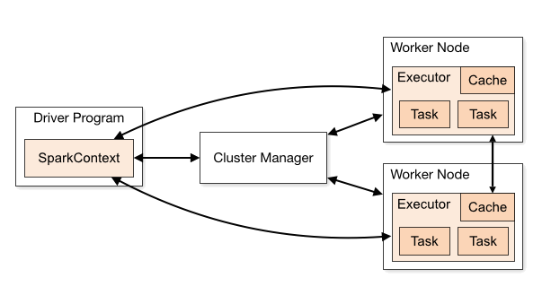
SparkSession vs. SparkContext
SparkContext is a conduit to access all Spark functionality; only a single SparkContext exists per JVM. The Spark driver program uses it to connect to the cluster manager to communicate, submit Spark jobs and knows what resource manager (YARN, Mesos or Standalone) to communicate to. It allows you to configure Spark configuration parameters. And through SparkContext, the driver can access other contexts such as SQLContext, HiveContext, and StreamingContext to program Spark.
However, with Spark 2.0, SparkSession can access all aforementioned Spark’s functionality through a single-unified point of entry. As well as making it simpler to access DataFrame and Dataset APIs, it also subsumes the underlying contexts to manipulate data.
Whereas in Spark 1.x you would have had to create individual contexts (for streaming, SQL, etc.), introducing extra boilerplate code, in a Spark 2.x application you can create a SparkSession per JVM and use it to perform a number of Spark operations.
30

Slide 31
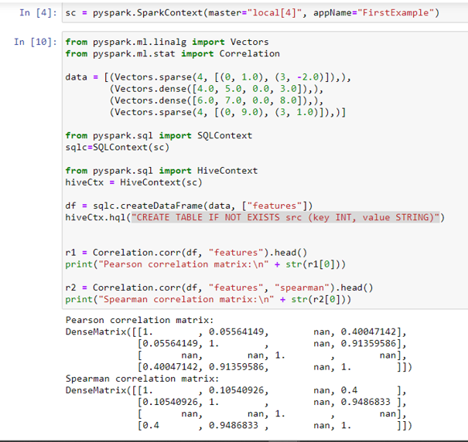
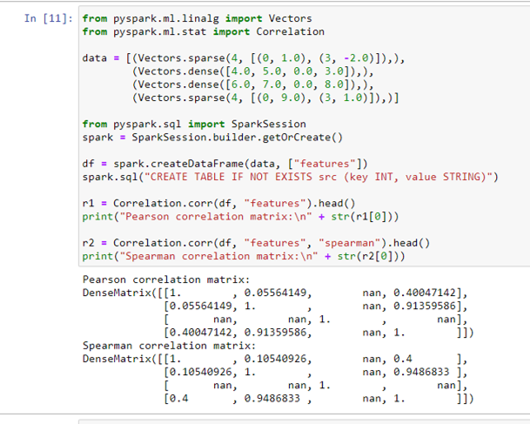
SparkSession vs. SparkContext
<number>

Slide 32
Cluster Manager
Cluster manager is responsible for managing and allocating resources for the cluster of nodes on which your Spark application runs.
Currently, Spark supports four cluster managers: the built-in standalone cluster manager, Apache Hadoop YARN, Apache Mesos, and Kubernetes.
32

Slide 33
Spark Executer
Spark Executer runs on each worker node in the cluster.
The executors communicate with the driver program and are responsible for executing tasks on the workers.
In most deployments modes, only a single executor runs per node.
33

Slide 34
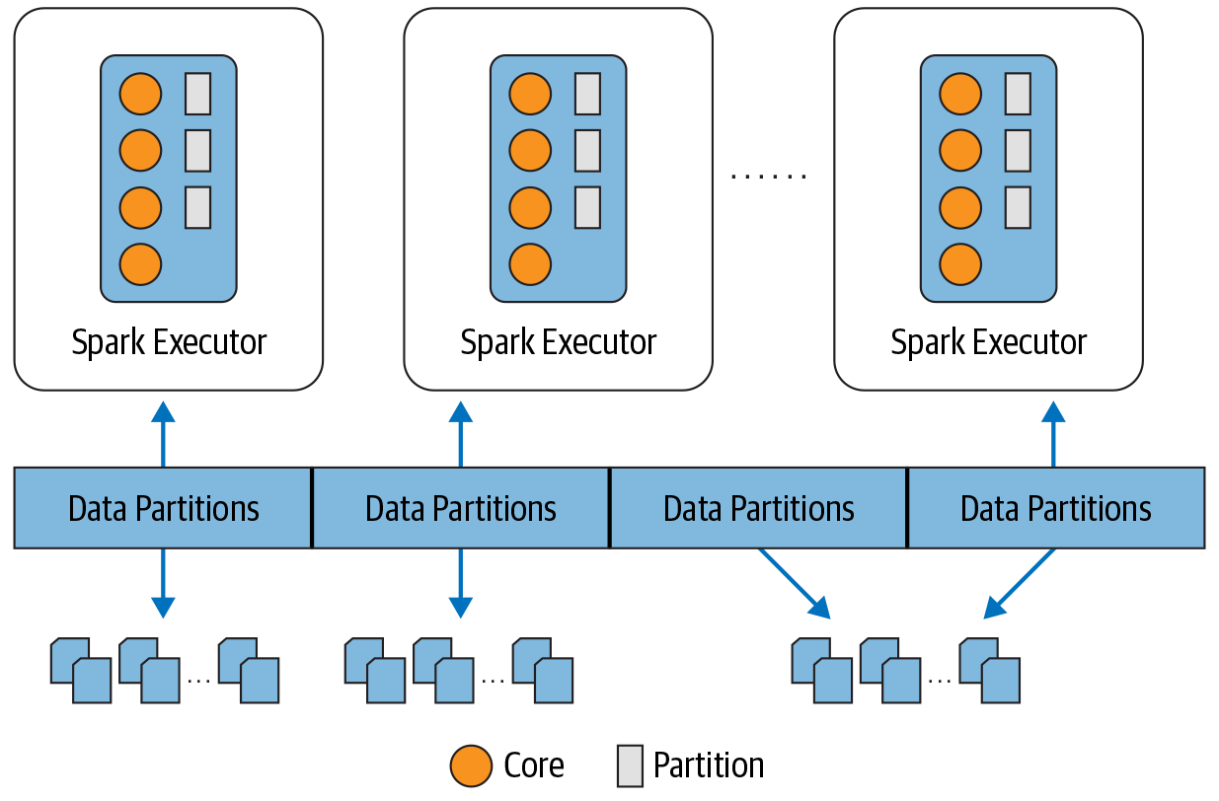
Distributed Data and Partitions
Partitioning allows for efficient parallelism. A distributed scheme of breaking up data into chunks or partitions allows Spark executors to process only data that is close to them, minimizing network bandwidth. That is, each executor’s core is assigned its own data partition to work on.
34

Slide 35
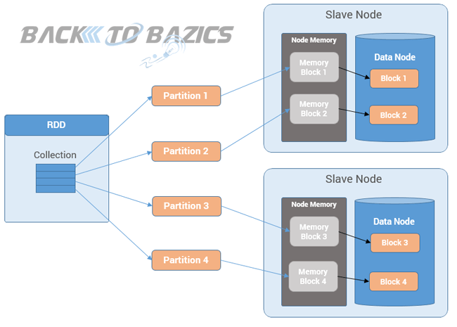
Reselient Distributed Dataset (RDD)
Resilient Distributed Datasets (RDD) is a fundamental data structure of Spark.
It is an immutable distributed collection of objects.
Each dataset in RDD is divided into logical partitions, which may be computed on different nodes of the cluster.
RDDs can contain any type of Python, Java, or Scala objects, including user-defined classes.
35

Slide 36
Reselient Distributed Dataset (RDD)
It supports in-memory processing computation. This means, it stores the state of memory as an object across the jobs and the object is sharable between those jobs.
Data sharing in memory is 10 to 100 times faster than network and Disk.
36

Slide 37
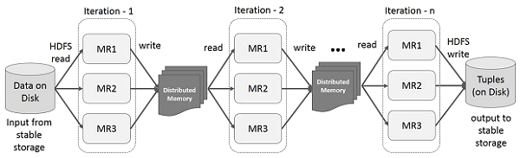
Reselient Distributed Dataset (RDD)
Iterative Operations on Spark RDD
It will store intermediate results in a distributed memory instead of Stable storage (Disk) and make the system faster.
If the Distributed memory (RAM) is not sufficient to store intermediate results (State of the JOB), then it will spill to the disk.
<number>

Slide 38
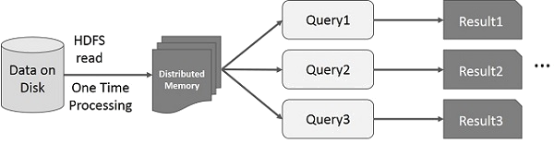
Reselient Distributed Dataset (RDD)
Interactive Operations on Spark RDD
If different queries are run on the same set of data repeatedly, this particular data can be kept in memory for better execution times.
<number>

Slide 39
Reselient Distributed Dataset (RDD)
Formally, an RDD is a read-only, partitioned collection of records.
RDDs can be created through deterministic operations on either data on stable storage or other RDDs.
RDD is a fault-tolerant collection of elements that can be operated on in parallel.
There are two ways to create RDDs − parallelizing an existing collection in your driver program, or referencing a dataset in an external storage system, such as a shared file system, HDFS, HBase, or any other data source.
Spark makes use of the concept of RDD to achieve faster and efficient MapReduce operations.
39

Slide 40
Reselient Distributed Dataset (RDD)
RDD was the primary user-facing API in Spark since its inception. At the core, an RDD is an immutable distributed collection of elements of your data, partitioned across nodes in your cluster that can be operated in parallel with a low-level API that offers transformations and actions.
Since Spark 2.x, RDDs are now consigned to low-level APIs.
Every computation expressed in high-level Structured APIs is decomposed into low-level optimized and generated RDD operations and then converted into Scala bytecode for the executors’ JVMs. This generated RDD operation code is not accessible to users, nor is it the same as the user-facing RDD APIs.
40

Slide 41
Reselient Distributed Dataset (RDD)
5 Reasons on When to use RDDs
You want low-level transformation and actions and control on your dataset;
Your data is unstructured, such as media streams or streams of text;
You want to manipulate your data with functional programming constructs than domain specific expressions;
You don’t care about imposing a schema, such as columnar format while processing or accessing data attributes by name or column; and
You can forgo some optimization and performance benefits available with DataFrames and Datasets for structured and semi-structured data.
41

Slide 42
Transformations/Actions
Spark operations on distributed data can be classified into two types: transformations and actions.
Transformations, as the name suggests, transform a Spark DataFrame into a new DataFrame without altering the original data, giving it the property of immutability.
Put another way, an operation such as select() or filter() will not change the original DataFrame; instead, it will return the transformed results of the operation as a new DataFrame.
All transformations are evaluated lazily. That is, their results are not computed immediately, but they are recorded or remembered as a lineage.
A recorded lineage allows Spark, at a later time in its execution plan, to rearrange certain transformations, coalesce them, or optimize transformations into stages for more efficient execution.
Lazy evaluation is Spark’s strategy for delaying execution until an action is invoked or data is “touched” (read from or written to disk).
An action triggers the lazy evaluation of all the recorded transformations.
42

Slide 43
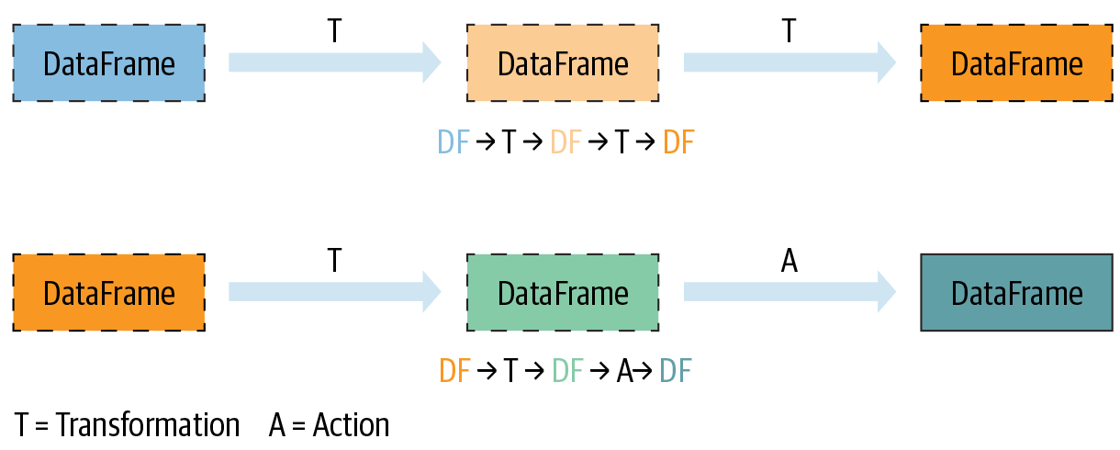
Transformations/Actions
all transformations T are recorded until the action A is invoked. Each transformation T produces a new DataFrame.
43

Slide 44
Why Spark?
Whether you are a data engineer, data scientist, or machine learning engineer, you’ll find Spark useful for the following use cases:
Processing in parallel large data sets distributed across a cluster.
Performing ad hoc or interactive queries to explore and visualize data sets.
Building, training, and evaluating machine learning models using Mllib.
Implementing end-to-end data pipelines from myriad streams of data.
Analyzing graph data sets and social networks Community Adoption.
44

Slide 45
References
https://courses.cognitiveclass.ai/courses/course-v1:BigDataUniversity+BD0101EN+2016_T2/course/
https://www.gartner.com/en/information-technology/glossary/big-data
https://www.domo.com/learn/infographic/data-never-sleeps-8
https://spark.apache.org/
Learning Spark: Lightning-Fast Data Analytics 2nd Edition by Jules S. Damji
https://towardsdatascience.com/graphframes-in-jupyter-a-practical-guide-9b3b346cebc5
https://databricks.com/blog/2016/08/15/how-to-use-sparksession-in-apache-spark-2-0.html
https://www.tutorialspoint.com/apache_spark/apache_spark_rdd.htm
Python for data science and machine learning bootcamp, course, Udemy.com
https://spark.apache.org/docs/latest/rdd-programming-guide.html#resilient-distributed-datasets-rdds
https://www.slideshare.net/SparkSummit/transformations-and-actions-a-visual-guide-training
https://spark.apache.org/docs/latest/sql-getting-started.html#untyped-dataset-operations-aka-dataframe-operations
https://www.kaggle.com/anthonypino/melbourne-housing-market?select=MELBOURNE_HOUSE_PRICES_LESS.csv
https://courses.cognitiveclass.ai/ (Hadoop 101, Big Data 101, Spark fundamentals 1)
https://databricks.com/glossary/hadoop-cluster
https://blogs.sap.com/2019/06/24/introduction-to-hadoop-in-simple-words/
45

